Slide 1
Gemap db structure

Slide 2
Six data source(current)
Repeat region data
CpG island data
dbSNP
EnsEMBL core and variation dbs
GWAS catalog
1000 genomes
More data source: SCANdb, COSMIC, GAD, GWASSP, GWASdb, PharmGKB, HGMD-public

Slide 3
Plan: combine all the data and build a base, compatible database for continuous growing data of different types.
Fact: because the deadline of the project, build six DBs for each source, extract the necessary data as searching index.

Slide 4
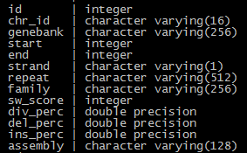

Repeat/CpG region data
Source: maybe repeatmasked/cpgplot1 tool output
one db has one table
repeat CpG

Slide 5

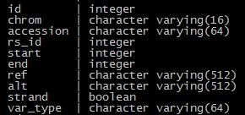
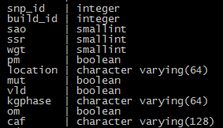

dbSNP
Source: NCBI dbSNP vcf file
Four tables: gene, snp, snpinfo, snpinfo_gene
gene snp
snpinfo
snpinfo_gene

Slide 6
EnsEMBL
Source: ensemble ftp server
Database schema:
http://asia.ensembl.org/info/docs/api/core/core_schema.html
http://asia.ensembl.org/info/docs/api/variation/variation_schema.html

Slide 7

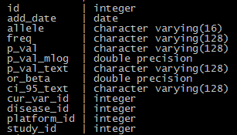


GWAS Catalog
Source: GWAS Catalog official website
14 tables: diseaseortrait, entry, entry_map_genes, entry_map_traits, entry_rep_genes, entry_rep_vars, gene, journal, mappedtrait, platform, study, variation, variationcontext, variationstream
diseaseortrait entry entry_map_genes
entry_map_traits entry_rep_genes

Slide 8





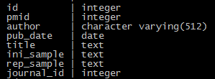



entry_rep_vars gene journal
mappedtraits platform study
variation
variationcontext variationstream

Slide 9




1000 genomes
Source: 1000 genomes official website
7 tables: population, populationgf, sample, sampleinfo, superpopgf, variation, varinfo (gf: genotype frequency)
population populationgf/superpopgf
sample
sampleinfo

Slide 10
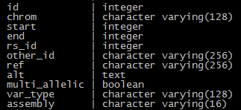
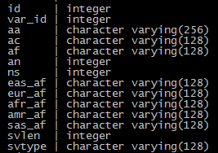
variation varinfo

Slide 11
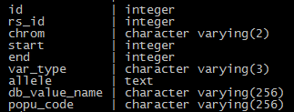
Search index of variation for gemap
7 tables(9 in the past): databaseindex, disseaseindex, geneindex, popindex, varindex, varindex_disease, varindex_gene, (deperated: varindex_database, varindex_pop)
Varindex
Data extraction:
Extract and deduplicate all variations’ position, allele, var_type and rs annotation from all source. Mark all variations with related db name, population code, disease name and gene symbol.

Slide 12
Logic of query backend
browser
request
if is a gene/disease use geneindex/diseaseindex
Filter the varindex with the special gene/disease and other args
YES
NO
Search all fields
Results?
Result page
0 or more than one hits
response
Detail page
1 hits

Slide 13
Plan for update/upgrade
Build a global base compatible database that fits any level of data of any species, to provide service of annotation, content display, visualization, etc.
Current process: designing the db

